Slide 1

Risk identification and risk assessment
Pham Cao Nguyen
Pham Thanh Dat
Trinh Le Tuong Duy

Slide 2
Step #1: Identify and Prioritize Assets
Assets include servers, client contact information, sensitive partner documents, trade secrets and so on. Remember, what you as a technician think is valuable might not be what is actually most valuable for the business. Therefore, you need to work with business users and management to create a list of all valuable assets. For each asset, gather the following information, as applicable:
Software
Hardware
Data
Interfaces
Users
Support personnel
Mission or purpose

Slide 3
Criticality
Functional requirements
IT security policies
IT security architecture
Network topology
Information storage protection
Information flow
Technical security controls
Physical security environment
Environmental security

Slide 4

Because most organizations have a limited budget for risk assessment, you will likely have to limit the scope of the remaining steps to mission-critical assets. Accordingly, you need to define a standard for determining the importance of each asset. Common criteria include the asset’s monetary value, legal standing and importance to the organization. Once the standard has been approved by management and formally incorporated into the risk assessment security policy, use it to classify each asset as critical, major or minor.

Slide 5
Step #2: Identify Threats
A threat is anything that could cause harm to your organization. While hackers and malware probably leap to mind, there are many other types of threats:
Natural disasters. Floods, hurricanes, earthquakes, fire and other natural disasters can destroy not just data, but servers and appliances as well. When deciding where to house your servers, think about the chances of different types of natural disasters. For instance, your area might have a high risk of floods but a low likelihood of tornadoes.
Hardware failure. The likelihood of hardware failure depends on the quality and age of the server or other machine. For relatively new, high-quality equipment, the chance of failure is low. But if the equipment is old or from a “no-name” vendor, the chance of failure is much higher

Slide 6
This threat should be on your list, no matter what business you are in. People can accidentally delete important files, click on a malicious link in an email or spill coffee on a piece of equipment that hosts critical systems.
Malicious behavior. There are three types of malicious behavior:
Interference is when somebody causes damage to your business by deleting data, engineering a distributed denial of service (DDOS) against your website, physically stealing a computer or server, and so on.
Interception is theft of your data.
Impersonation is misuse of someone else’s credentials, which are often acquired through social engineering attacks or brute-force attacks, or purchased on the dark web.

Slide 7
Step #3: Identify Vulnerabilities
A vulnerability is a weakness that could enable a threat to harm your organization. Vulnerabilities can be identified through analysis, audit reports, the NIST vulnerability database, vendor data, information security test and evaluation (ST&E) procedures, penetration testing, and automated vulnerability scanning tools.
Don’t limit your thinking to software vulnerabilities; there are also physical and human vulnerabilities. For example, having your server room in the basement increases your vulnerability to the threat of flooding, and failure to educate your employees about the danger of clicking on email links increases your vulnerability to the threat of malware.

Slide 8
Step #4: Analyze Controls
Analyze the controls that are either in place or in the planning stage to minimize or eliminate the probability that a threat will exploit a vulnerability. Technical controls include encryption, intrusion detection mechanisms, and identification and authentication solutions. Nontechnical controls include security policies, administrative actions, and physical and environmental mechanisms.
Both technical and nontechnical controls can further be classified as preventive or detective. As the name implies, preventive controls attempt to anticipate and stop attacks; examples include encryption and authentication devices. Detective controls are used to discover threats that have occurred or are in process; they include audit trails and intrusion detection systems.

Slide 9
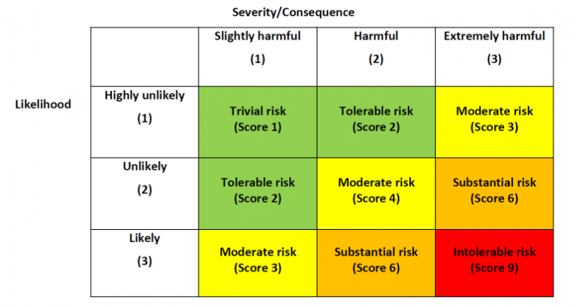
Step #5: Determine the Likelihood of an Incident
Assess the probability that a vulnerability might actually be exploited, taking into account the type of vulnerability, the capability and motivation of the threat source, and the existence and effectiveness of your controls. Rather than a numerical score, many organizations use the categories high, medium and low to assess the likelihood of an attack or other adverse event.

Slide 10
Step #6: Assess the Impact a Threat Could Have
Analyze the impact that an incident would have on the asset that is lost or damaged, including the following factors:
The mission of the asset and any processes that depend upon it
The value of the asset to the organization
The sensitivity of the asset
To get this information, start with a business impact analysis (BIA) or mission impact analysis report. This document uses either quantitative or qualitative means to determine the impact of harm to the organization’s information assets, such as loss of confidentiality, integrity and availability. The impact on the system can be qualitatively assessed as high, medium or low.

Slide 11
Step #7: Prioritize the Information Security Risks
For each threat/vulnerability pair, determine the level of risk to the IT system, based on the following:
The likelihood that the threat will exploit the vulnerability
The approximate cost of each of these occurrences
The adequacy of the existing or planned information system security controls for eliminating or reducing the risk
A useful tool for estimating risk in this manner is the risk-level matrix. A high likelihood that the threat will occur is given a value of 1.0; a medium likelihood is assigned a value of 0.5; and a low likelihood of occurrence is given a rating of 0.1. Similarly, a high impact level is assigned a value of 100, a medium impact level 50, and a low impact level 10. Risk is calculated by multiplying the threat likelihood value by the impact value, and the risks are categorized as high, medium or low based on the result.

Slide 12
Step #8: Recommend Controls
Using the risk level as a basis, determine the actions needed to mitigate the risk. Here are some general guidelines for each level of risk:
High — A plan for corrective measures should be developed as soon as possible.
Medium — A plan for corrective measures should be developed within a reasonable period of time.
Low — The team must decide whether to accept the risk or implement corrective actions

Slide 13
As you evaluate controls to mitigate each risk, be sure to consider:
Organizational policies
Cost-benefit analysis
Operational impact
Feasibility
Applicable regulations
The overall effectiveness of the recommended controls
Safety and reliability

Slide 14
Step #9: Document the Results
The final step in the risk assessment process is to develop a risk assessment report to support management in making appropriate decisions on budget, policies, procedures and so on. For each threat, the report should describe the corresponding vulnerabilities, the assets at risk, the impact to your IT infrastructure, the likelihood of occurrence and the control recommendations.

Slide 15
List of steps to design a particular security policy.
1. Identify your risks
What are your risks from inappropriate use? Do you have information that should be restricted? Do you send or receive a lot of large attachments and files? Are potentially offensive attachments making the rounds? It might be a nonissue. Or it could be costing you thousands of dollars per month in lost employee productivity or computer downtime.

Slide 16
A good way to identify your risks can be through the use of monitoring or reporting tools. Many vendors of firewalls and Internet security products allow evaluation periods for their products. If those products provide reporting information, it can be helpful to use these evaluation periods to assess your risks. However, it's important to ensure that your employees are aware that you will be recording their activity for the purposes of risk assessment, if this is something you choose to try. Many employees may view this as an invasion of their privacy if it's attempted without their knowledge.

Slide 17
2. Learn from others
There are many types of security policies, so it's important to see what other organizations like yours are doing. You can spend a couple of hours browsing online, or you can buy a book such as Information Security Policies Made Easy by Charles Cresson Wood, which has more than 1,200 policies ready to customize. Also, talk to the sales reps from various security software vendors. They are always happy to give out information.

Slide 18
3. Make sure the policy conforms to legal requirements
Depending on your data holdings, jurisdiction and location, you may be required to conform to certain minimum standards to ensure the privacy and integrity of your data, especially if your company holds personal information. Having a viable security policy documented and in place is one way of mitigating any liabilities you might incur in the event of a security breach.

Slide 19
4. Level of security = level of risk
Don't be overzealous. Too much security can be as bad as too little. You might find that, apart from keeping the bad guys out, you don't have any problems with appropriate use because you have a mature, dedicated staff. In such cases, a written code of conduct is the most important thing. Excessive security can be a hindrance to smooth business operations, so make sure you don't overprotect yourself.

Slide 20
5. Include staff in policy development
No one wants a policy dictated from above. Involve staff in the process of defining appropriate use. Keep staff informed as the rules are developed and tools are implemented. If people understand the need for a responsible security policy, they will be much more inclined to comply.

Slide 21
6. Train your employees
Staff training is commonly overlooked or underappreciated as part of the AUP implementation process. But, in practice, it's probably one of the most useful phases. It not only helps you to inform employees and help them understand the policies, but it also allows you to discuss the practical, real-world implications of the policy. End users will often ask questions or offer examples in a training forum, and this can be very rewarding. These questions can help you define the policy in more detail and adjust it to be more useful.

Slide 22
7. Get it in writing
Make sure every member of your staff has read, signed and understood the policy. All new hires should sign the policy when they are brought on board and should be required to reread and reconfirm their understanding of the policy at least annually. For large organizations, use automated tools to help electronically deliver and track signatures of the documents. Some tools even provide quizzing mechanisms to test user's knowledge of the policy

Slide 23
8. Set clear penalties and enforce them
Network security is no joke. Your security policy isn't a set of voluntary guidelines but a condition of employment. Have a clear set of procedures in place that spell out the penalties for breaches in the security policy. Then enforce them. A security policy with haphazard compliance is almost as bad as no policy at all.

Slide 24
9. Update your staff
A security policy is a dynamic document because the network itself is always evolving. People come and go. Databases are created and destroyed. New security threats pop up. Keeping the security policy updated is hard enough, but keeping staffers aware of any changes that might affect their day-to-day operations is even more difficult. Open communication is the key to success.

Slide 25
10. Install the tools you need
Having a policy is one thing, enforcing it is another. Internet and e-mail content security products with customizable rule sets can ensure that your policy, no matter how complex, is adhered to. The investment in tools to enforce your security policy is probably one of the most cost-effective purchases you will ever make.
--The end--

